Slide 1
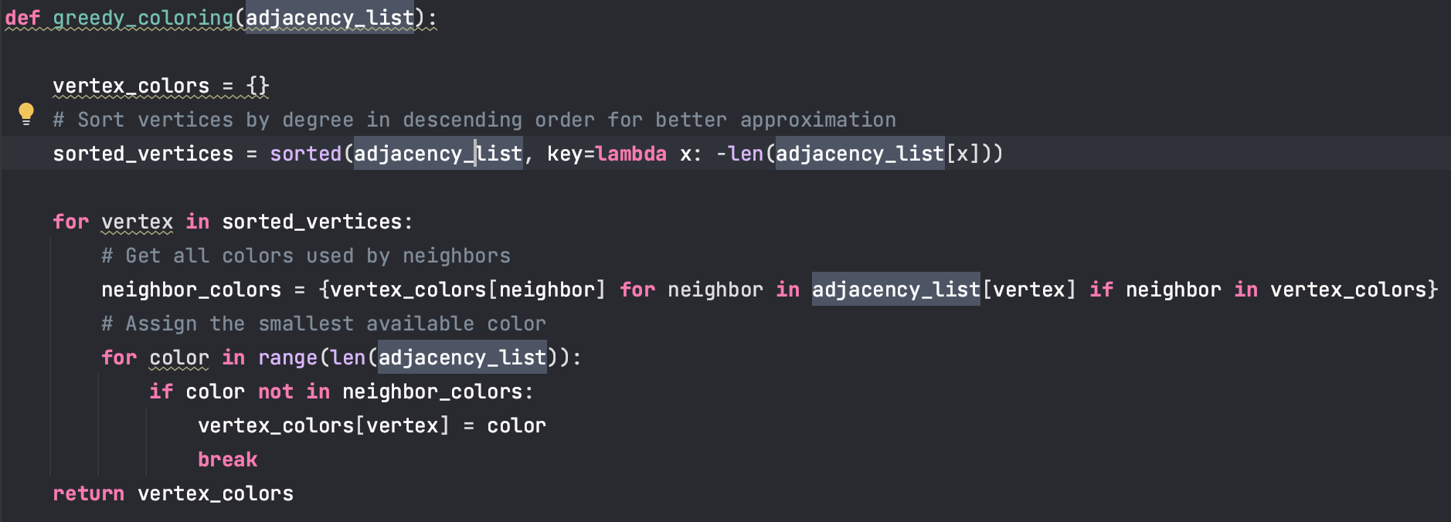
Approximation!
Greedy Strategy in Graph Coloring
Local Optimal Choice:
At each step, the algorithm assigns the smallest possible color to the current vertex.
It prioritizes minimizing conflicts with neighbors.
Irrevocable Decisions:
Once a vertex is assigned a color, it does not revisit or change the assignment.
This ensures simplicity and efficiency.

Slide 2
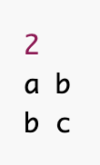
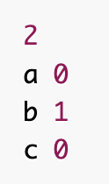
Greedy Graph Coloring
Input:
A graph represented as an adjacency list (adjacency_list)
Output:
A dictionary mapping each vertex to a color (vertex_colors)

Slide 3
Initialize:
Create an empty dictionary vertex_colors to store the colors of vertices.
Sort Vertices by Degree:
Sort vertices in descending order of their degree (number of neighbors).
For Each Vertex in Sorted Order:
Find Neighbor Colors:
Create a set neighbor_colors of all colors assigned to the vertex's neighbors.
Assign Smallest Available Color:
For each color starting from 0:
If the color is not in neighbor_colors, assign it to the vertex.
Break the loop.
Return:
The dictionary vertex_colors.

Slide 4
Verify Graph Coloring
Input:
A graph represented as an adjacency list (adjacency_list)
A dictionary of vertex-to-color mappings (vertex_colors)
Output:
A boolean indicating whether the coloring is valid.

Slide 5
Check All Vertices Are Colored:
For each vertex in adjacency_list:
If the vertex is not in vertex_colors, return False.
Check Adjacent Vertices for Conflicts:
For each vertex in adjacency_list:
For each neighbor of the vertex:
If the vertex and its neighbor share the same color, return False.
Return True if no conflicts are found.

Slide 6
Overall worst-case runtime is O(V²), which is polynomial in the input size. This comes from:
Reading graph: O(E)
Greedy coloring: O(V²)
Verification: O(V + E)
The V² term from the greedy coloring dominates all other terms, making the total runtime O(V²).

Slide 7
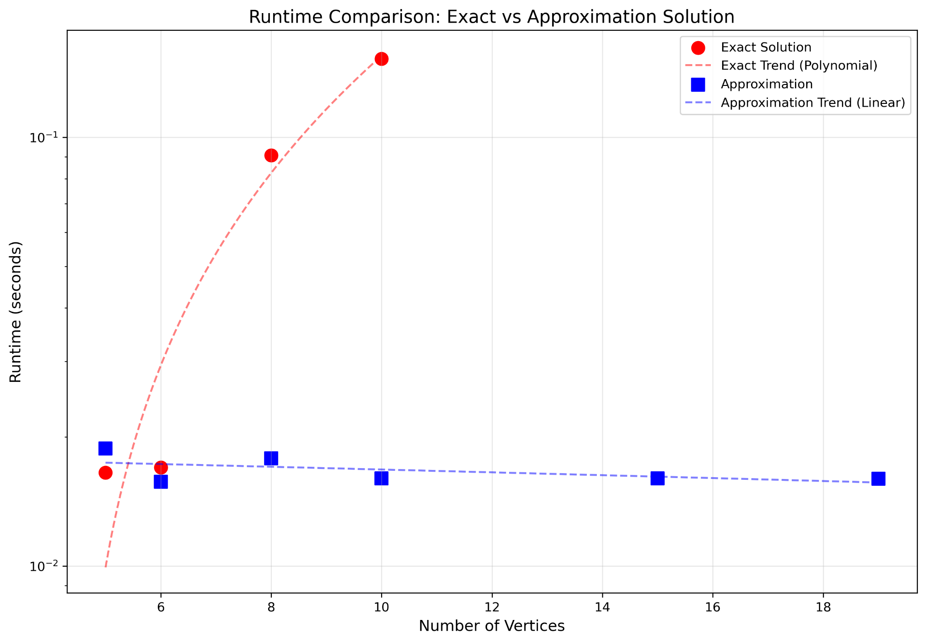

Slide 8
